Slide 1

Environmental Impacts of Agriculture: Balancing Growth with Sustainability
Agriculture is vital for our food, but it also has environmental impacts. We'll explore how agriculture can be sustainable while meeting the needs of our planet and future generations.

Slide 2
Environmental Impacts of Agriculture
Deforestation
Soil Degradation
Water Pollution
Greenhouse Gas Emissions
Loss of forests for farmland
Erosion, nutrient depletion, salinization
Pesticide runoff, fertilizer use, animal waste
Livestock, fertilizer production, land use change

Slide 3
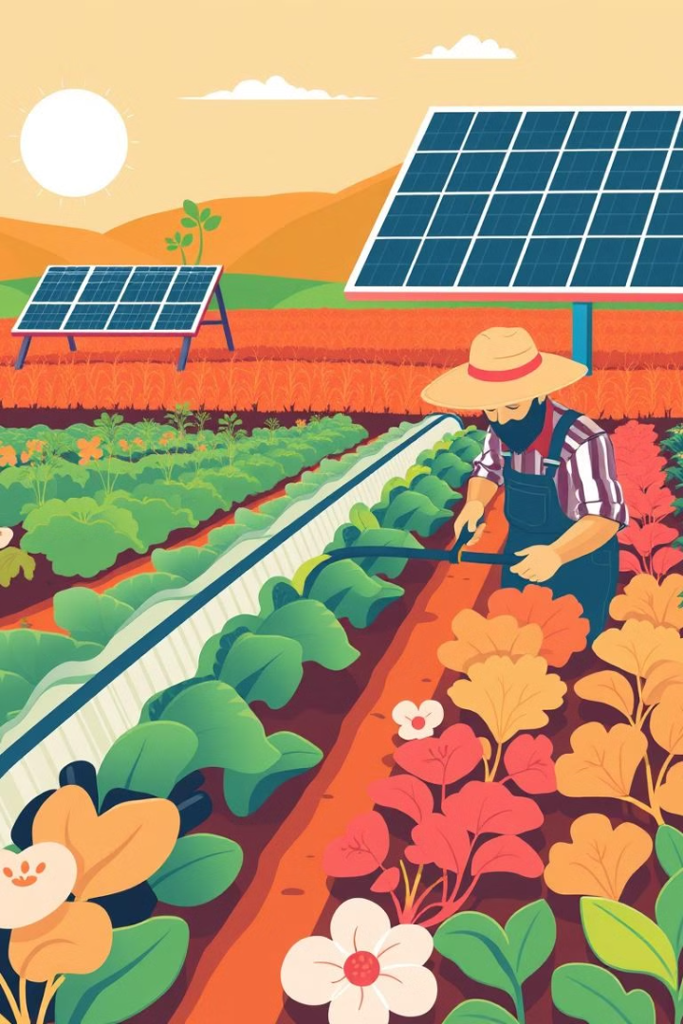
Mitigation Strategies
1
Organic Fertilizers
2
Crop Rotation
Reduce synthetic fertilizer use, improve soil health
Break pest cycles, improve soil fertility, reduce monoculture dependence
3
Water Conservation
4
Renewable Energy
Drip irrigation, rainwater harvesting, efficient water management
Solar, wind, biogas, reducing fossil fuel reliance

Slide 4
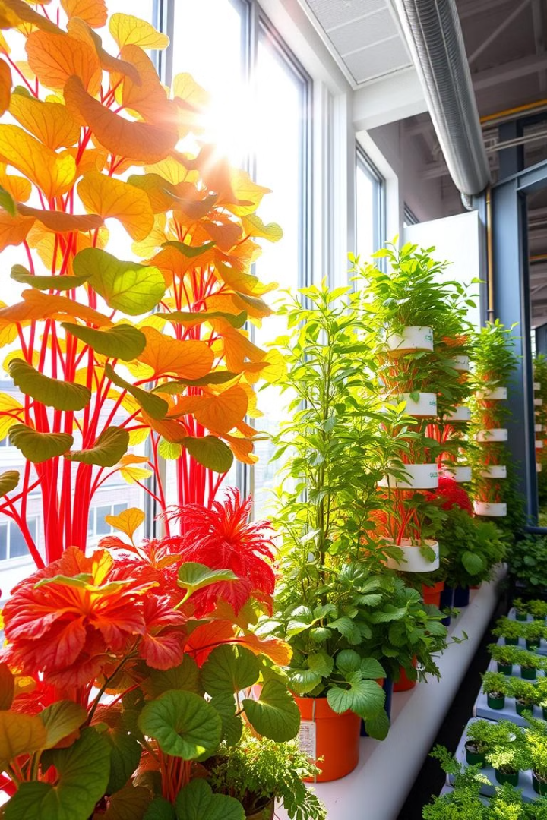
Sustainable Farming Practices
Agroecology
Permaculture
Integrate ecological principles to improve farm resilience
Mimics natural ecosystems for self-sustaining food production
No-Till Farming
Vertical Farming
Reduces soil disturbance, promotes carbon sequestration
Urban farming using vertical space for efficient food production

Slide 5
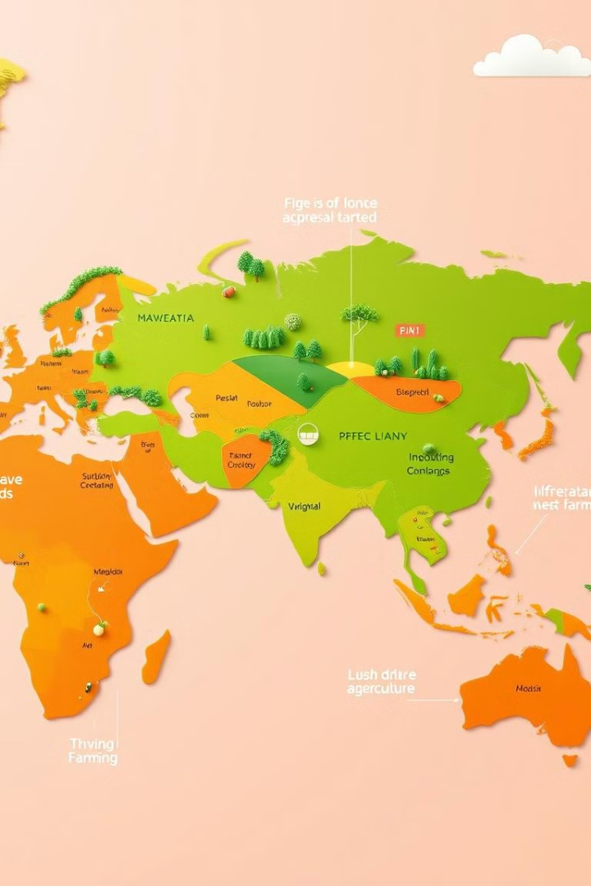
Global Initiatives
1
Carbon Farming
Paying farmers for sequestering carbon in the soil
2
Regenerative Agriculture
Focuses on restoring soil health and biodiversity
3
Sustainable Agriculture Policies
Government regulations, incentives, and funding for sustainable practices

Slide 6




Examples of Sustainable Agriculture
Agroforestry
Pollinator-Friendly Farming
Water-Efficient Farming
Integrating trees with crops for ecological benefits
Creating habitats for pollinators, promoting biodiversity
Using irrigation techniques that minimize water use

Slide 7
The Future of Food
Innovation
1
Technological advances in precision agriculture
Education
2
Raising awareness about sustainable practices
Collaboration
3
Partnerships between farmers, researchers, and policymakers

Slide 8

A Sustainable Future
Together, we can transform agriculture for a better future. By embracing sustainable practices, we can ensure food security, protect our environment, and create a more sustainable world for generations to come.

